Slide 1
VOICE FOR DUMB-MUTE PEOPLE
Hand Gesture Recognition Using Image Processing for mute and Dumb Person
TEAM-WE KNOW NOTHING.
RAJAN JAISWAL
GAURAV TRIPATHI
AMAN GUPTA
ANCHUL SHARMA
PRABHUPAD

Slide 2
OUR MOTIVATION AND OBJECTIVE
Communication is one of the a basic need in every person's life.Just imagine how miserable it will be if you are not able to communicate for a day, and that what deaf and dumb people experience everyday.Deaf and dumb people experience a hard time while trying to converse with normal people not only in public but also in their own home they face difficulties in their day to day life.Sign language can also be the solution but here the knowledge of sign language becomes the necessity in this case for normal persons. There should be an automated translation system between the sign language and audio/speech which will ease the communication with deaf-mute people.
So,our objective is to design a Device/App which make communication easier for deaf-mute and dumb people by converting the sign language into audio/speech

Slide 3
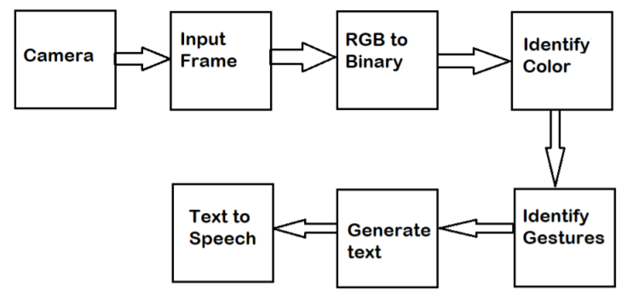
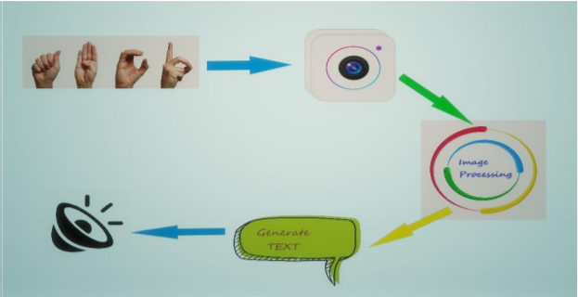

Slide 4
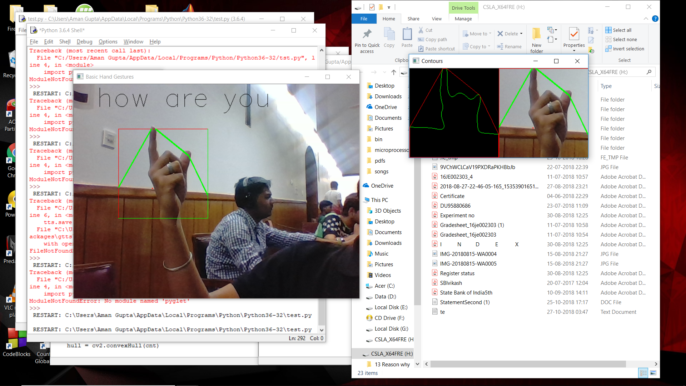

Slide 5
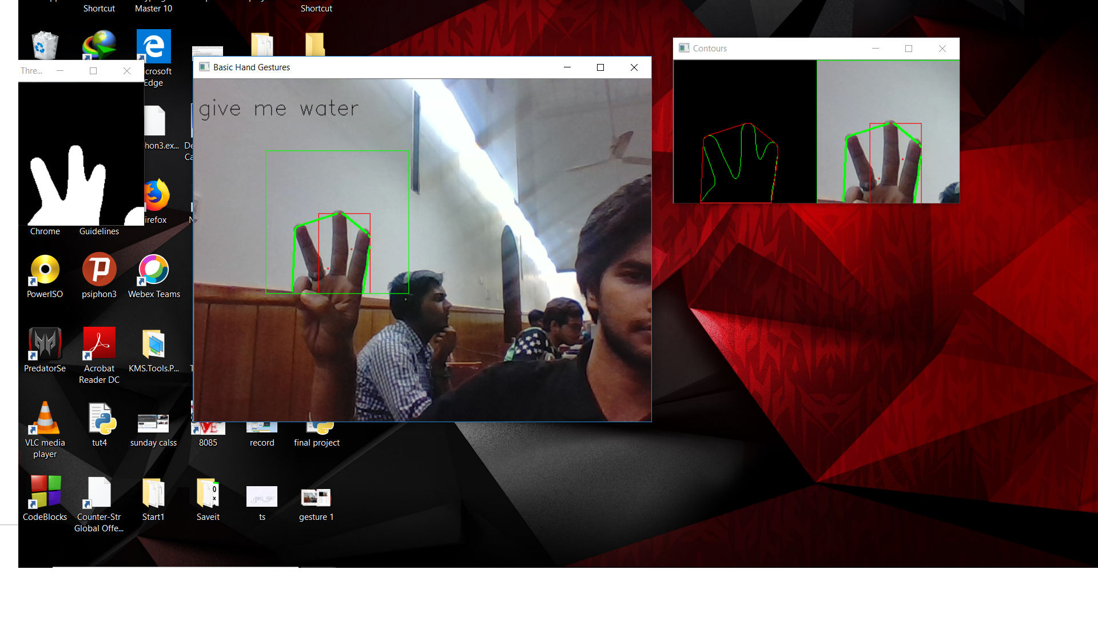

Slide 6
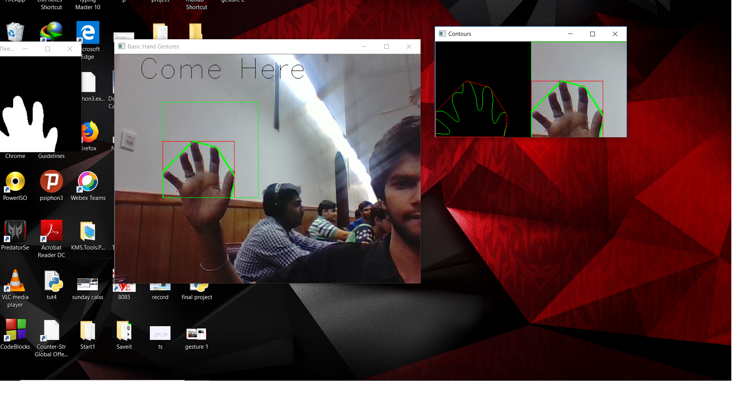

Slide 7
IMPLEMENTATION
:-DIRECTLY USED BY MUTE PEOPLE TO COMMUNICATE WITH OTHER USING SIGN LANGUAGE TO SPEECH.
:-USED IN TEACHING SIGN LANGUAGE TO MUTE AND DUMB
:-CAN ALSO BE USED AS WIRELESS KEYBOARD.

Slide 8
THANK YOU

